Slide 1
HTML FORMS

Slide 2
Developing
HTML Forms

Slide 3
Form
An HTML form is a section of a document containing normal content, markup, special elements called controls (checkboxes, radio buttons, menus, etc.), and labels on those controls.
Users generally "complete" a form by modifying its controls (entering text, selecting menu items, etc.), before submitting the form to an agent for processing (e.g., to a Web server, to a mail server, etc.)

Slide 4
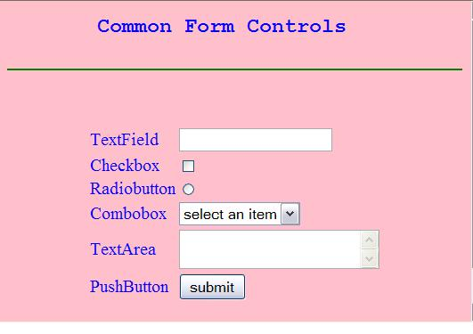
Form (Contd.)
A form is defined with the <form> tag.
Notes:
Discuss about the attribute - name, action and method

Slide 5
Form Controls
TextField:
  Are used to accept user input. It is a single line input control.
CheckBox
  Checkboxes are used when you want the user to select one or more options of a limited number of choices.
RadioButton
  Radio Buttons are used when you want the user to select one of a limited number of choices.
Select
  Are used when you want users to choose options from a selectable lists.
TextArea
  Are used to accept user input. TextArea allows entry of multiple lines.
Notes:
Checkboxes (and radio buttons) are on/off switches that may be toggled by the user. A switch is "on" when the control element's checked attribute is set. When a form is submitted, only "on" checkbox controls can become successful. Several checkboxes in a form may share the same control name. Thus, for example, checkboxes allow users to select several values for the same property. The INPUT element is used to create a checkbox control.

Slide 6
Form Controls (Contd.)
PushButton
  Each push button may have client side script associated with the element's event attributes. When an event occurs (e.g., the user presses the button, releases it, etc.), the associated script is triggered.
Submit Button
  When activated, a submit button submits a form. A form may contain more than one submit button.
Reset Button
  When activated, a reset button resets all controls to their initial values.
Notes:
Use an upload form to allow users to upload pictures, movies, or even their own webpages. An upload form is another type of input form, simply set the type attribute to file.
HTML Code:
<input type="file" />

Slide 7
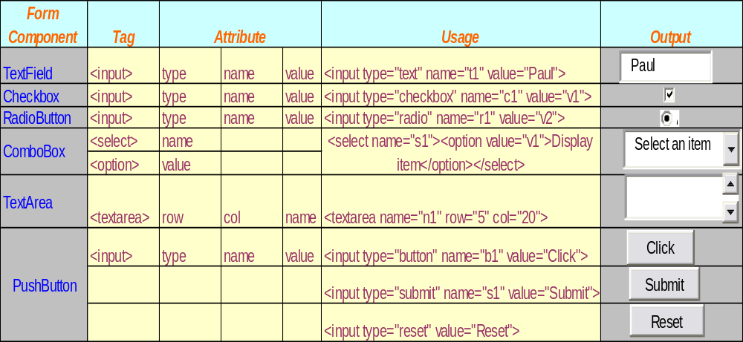
Form Controls (Contd)
Notes:
Push button can also be created using <BUTTON></BUTTON> tag.

Slide 8
Example of a Form
<html>
<head>
<title>
Form Example</title>
</head>
<body bgcolor=pink >
<center>
<h3> Data Entry Form</h3>
<form>
<table>
<tr><td>Name</td><td> <input type="text" name="t1"> </td></tr>
<tr><td>Gender</td><td> <input type="radio" name=“r1” value=“m”> Male
<input type="radio" name=“r1” value=“f”>Female</td></tr>
<tr><td>Qualification</td><td><select name=“s”>
<option >Select</option>
<option value=“M.Sc”>M Sc</option>
<option value=“M.A.”>MA</option>
<option value="other">other</option></select>
</td></tr>
<tr><td> <input type="submit" value="submit"> </td>
<td> <input type="reset" value="reset"> </td></tr>
</table>
</center>
</form>
</body>
</html>

Slide 9
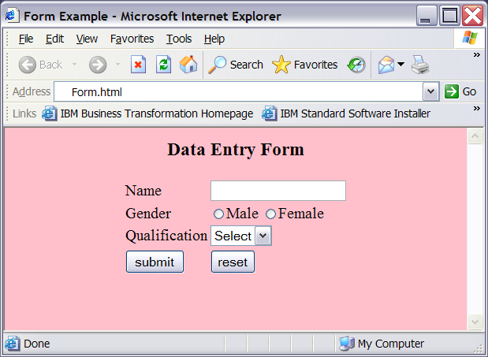
Output of the Form

Slide 10
Fieldset & Legend Tag
The fieldset tag is used to group the form elements whilst the legend
tag provides a label for the fieldset.
The HTML legend tag is used for labelling the fieldset element.
By using the fieldset tag and the legend tag, you can make your
forms much easier to understand for your users.

Slide 11
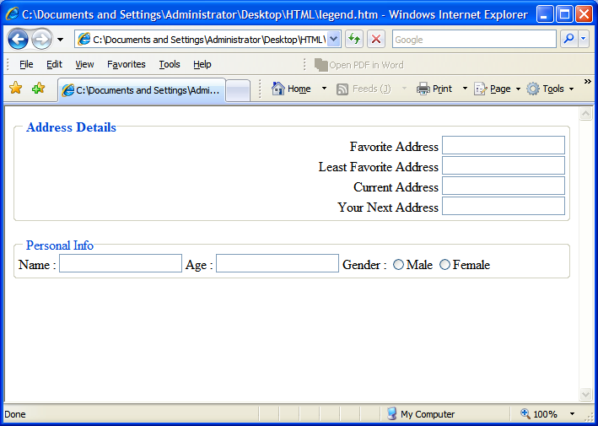
Output Required

Slide 12
Code Snippet
<fieldset align="left">
<legend>Personal Info</legend>
Name : <input type="text">
Age : <input type="text">
Gender :
<input type="radio" name="r1">Male
<input type="radio" name="r1">Female
</fieldset>
</body>
</html>
<html>
<body>
<fieldset style="text-align:right;">
<legend><b>Address Details</b></legend>
Favorite Address <input type="text" /><br/>
Least Favorite Address <input type="text" /><br/>
Current Address <input type="text" /><br/>
Your Next Address <input type="text" /><br/>
</fieldset>
<br>

Slide 13
<fieldset> tag is used to group the form elements
<fieldset align="left">
<legend>Personal Info</legend>
Name : <input type="text">
Age : <input type="text">
Gender :
<input type="radio" name="r1">Male
<input type="radio" name="r1">Female
</fieldset>
</body>
</html>
<html>
<body>
<fieldset style="text-align:right;">
<legend><b>Address Details</b></legend>
Favorite Address <input type="text" /><br/>
Least Favorite Address <input type="text" /><br/>
Current Address <input type="text" /><br/>
Your Next Address <input type="text" /><br/>
</fieldset>
<br>

Slide 14
<legend> tag is used give a suitable label to the group.
<fieldset align="left">
<legend>Personal Info</legend>
Name : <input type="text">
Age : <input type="text">
Gender :
<input type="radio" name="r1">Male
<input type="radio" name="r1">Female
</fieldset>
</body>
</html>
<html>
<body>
<fieldset style="text-align:right;">
<legend><b>Address Details</b></legend>
Favorite Address <input type="text" /><br/>
Least Favorite Address <input type="text" /><br/>
Current Address <input type="text" /><br/>
Your Next Address <input type="text" /><br/>
</fieldset>
<br>

Slide 15
Given a Label using legend tag
Created groups using fieldset tag

Slide 16
Form Controls using Attributes:
INPUT Attribute definitions
type = text|password|checkbox|radio|submit|reset|file|hidden|image|button
  This attribute specifies the ‘type of control’ to create. The default value for this attribute is "text".
name = cdata
  This attribute assigns the ‘control name’.
value = cdata
  This attribute specifies the ‘initial value’ of the control. It is optional except when the ‘type’ attribute has the value "radio" or "checkbox".
size = cdata
  This attribute tells the initial width of the control. The width is given in pixels except when ‘type’ attribute has the value "text" or "password". In that case, its value refers to the (integer) number of characters.

Slide 17
Form Controls using Attributes:
INPUT Attribute definitions (Contd …)
maxlength = number
  When the ‘type’ attribute has the value "text" or "password", this attribute specifies the maximum number of characters the user may enter. This number may exceed the specified ‘size’, in which case the user should offer a scrolling mechanism. The default value for this attribute is an unlimited number.
Checked
  When the ‘type’ attribute has the value "radio" or "checkbox", this boolean attribute specifies that the button is on.
src = uri
  When the ‘type’ attribute has the value "image", this attribute specifies the location of the image to be used to decorate the graphical submit button.

Slide 18
Form Controls using Attributes:
SELECT Attribute definitions
name = cdata
  This attribute assigns the control name.
size = number
  If a SELECT element is presented as a scrolled list box, this attribute specifies the number of rows in the list that should be visible at the same time.
Multiple
  If set, this boolean attribute allows multiple selections. If not set, the SELECT element only permits single selections.

Slide 19
Pre – Selected Options:
Zero or more choices may be pre-selected for the user. Users should determine which choices are pre-selected as follows:
  If no ‘OPTION’ element has the ‘selected’ attribute set, the initial state has the first option selected.
  If one ‘OPTION’ element has the ‘selected’ attribute set, it should be pre-selected.
  If the ‘SELECT’ element has the ‘multiple’ attribute set and more than one ‘OPTION’ element has the ‘selected’ attribute set, they should all be pre-selected.
  It is considered an error if more than one ‘OPTION’ element has the ‘selected’ attribute set and the ‘SELECT’ element does not have the ‘multiple’ attribute set.

Slide 20
Summary
HTML is used for publishing web page.
A tag is a reference in an HTML document which describes the style and structure of the document.
<TABLE> with <TR>,<TH>,<TD> tags are used to construct a tabular structure in HTML.
To create a List of items in HTML, tags used are <OL>and <UL>.
Tags that separate from one line to others are <P>, <BR>, <HR>.
It is used to include preformatted text into your HTML document.
<BLOCKQUOTE> tag is used to include indented text in a document.
The purpose of Logical Character Style tags is to convey the basic semantic meaning of a piece of text rather than the absolute appearance.
Physical Character Style tags is used to give your text a different look but exacting look.
<Font> tag is used to change the font size, color and face in a document.

Slide 21
Summary (Contd.)
Special characters are those that has a special meaning in HTML and those are not found on English keyboards.
HTML uses the <a> (anchor) tag to create a link to another document.
In Html images are defined by using the <img> tag
The <img> tag is a open tag ( does not have a </img>)
Web style sheets are a form of separation of presentation and content for web design .
CSS syntax is made up of three parts: Selector, property and value
Internal style sheets are used when a unique style is required for a document.
Internal style are defined in the <head> tag section by using the <style> tag

Slide 22
Summary (Contd.)
Internal style sheets are used when a unique style is required for a document.
Internal style are defined in the <head> tag section by using the <style> tag
With the class selector you can define different styles for the same type of HTML element
<Span> is a inline tag.
Span is used to format small chunks of data within another element.An HTML form is a section of a document containing normal content, markup, special elements called controls.
Some of the common controls are checkboxes, radio buttons, Textfields, etc.
Fieldset & Legend tags are used for grouping form elements and giving a suitable name to the group respectively.

Slide 23
Test Your Understanding
1. Select the correct option for making a hyperlink?
a. <a href="http://www.w3schools.com">W3Schools</a>
b. <a url="http://www.w3schools.com">W3Schools.com</a>
c. <a>http://www.w3schools.com</a>
d. <a name="http://www.w3schools.com">W3Schools.com</a>
2. Style Sheet can decide presentation of a web page
a. false
b. true

Slide 24
Test Your Understanding (Contd.)
3. The <style> tag should be embedded within:
a. <body>
b. <form>
c. <head>
d. <img>
4. With the _________selector you can define different styles for the same type of HTML element.
Form
Button
Span
class

Slide 25
Test Your Understanding (Contd.)
5. The ___________ attribute of table tag separates text from the cell border
a. CELLPADDING
b. CELLSPACING
c. BORDERSPACING
d. TABLESPACING
6. What is the default font size in a web page.
1
2
3
5

Slide 26
Test Your Understanding (Contd.)
Match Group A with B
Group A
Group B
a. <TR>
i. Emphasizes the text enclosed within it.
b. <SPAN>
ii. Used to group the form elements.
c. <STRONG>
iii. Creates a horizontal rule.
d. <FIELDSET>
iv. Creates a new row in a table
e. <HR>
v. Used to format small chunks of data.

